Slide 1
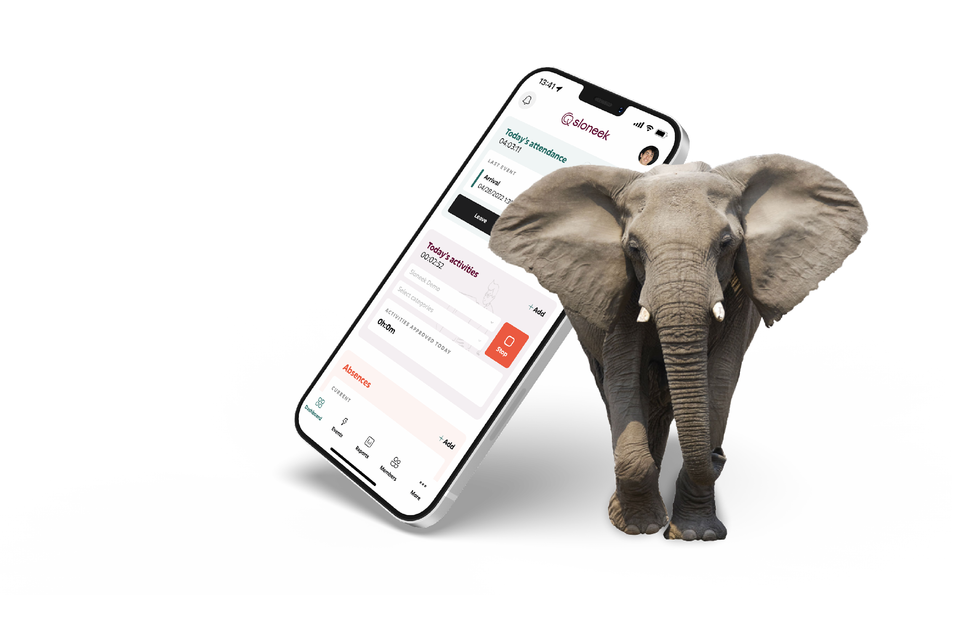
Sloneek: practical tips to get you started
User guide
2023 © Sloneek Europe s.r.o.

Slide 2
What is Sloneek and why do we have it?
Sloneek is an online application that helps you to:
Enter holidays and track your current balances
Log your attendance or work activities and easily check how much you've worked on a given month
Sign documents and accept work assets
c
Anonymously post messages to your inbox
🤝 Sloneek is designed to streamline processes, facilitate communication and offer you a perfect overview of your work and what's going on in your company.

Slide 3
Setting a password and logging into the app
?
More info
After your HR activates your Sloneek accounts, you will receive an activation email with a link to create a password.
Click on the link, set your password and log in to the app. 👌
If you have a corporate Google or Microsoft email, you don't need to set a password. Just go to the login page and sign in with Google or Microsoft.

Slide 4
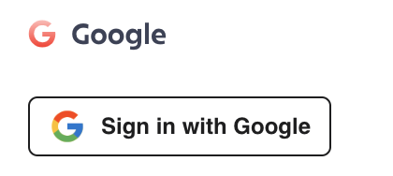
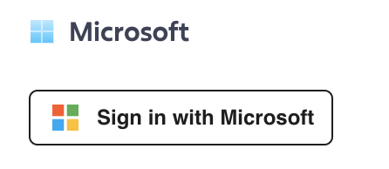
Connect your calendars
?
Go to My Profile / Notifications and Integrations in the app..
Click on one of the following buttons at the bottom of the page:
Give the app the necessary permissions, then just select the calendars you want to connect.

Slide 5
How to enter vacation and other absences?
?
Click on the New Absence button directly from the main desktop or from the Absence Calendar or My Absence section.
Choose from the available absences in the dialog box, enter a time range and let the system check if everything is alright.
If it is, create the absence. 🙂
💡 You can find all your balances and absences in the My absences section.

Slide 6
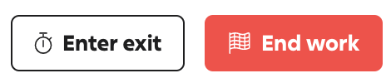
How to clock in and clock out?
?
👉 When you arrive at work, click on the Enter Arrival button directly from the main desktop.
👈 When you leave work, there are two buttons to choose from:
If you are ending your work day, select the End Work button. If you are still coming back to work and are only leaving for lunch, a break or a doctor's appointment, click the Enter Exit button. Once you are back, you will enter your arrival again.

Slide 7
How do I record my work activities?
?
⏯ In Sloneek you can plan activities in advance, enter them retrospectively and launch them live using timetracking.
📆 The process of entering activities in advance and retrospectively:
Click on the New Activity button directly from the main desktop or activity calendar.
Select from the available activities in the dialog box and/or select a client and project. Enter a time range and enter the activity.
⏱ Procedure for launching activities via timetracking:
Click the button with the Play icon in the upper right corner.
Select from the menu of activities, clients and projects and start timetracking.
When you are finished working on the activity, stop timetracking.

Slide 8
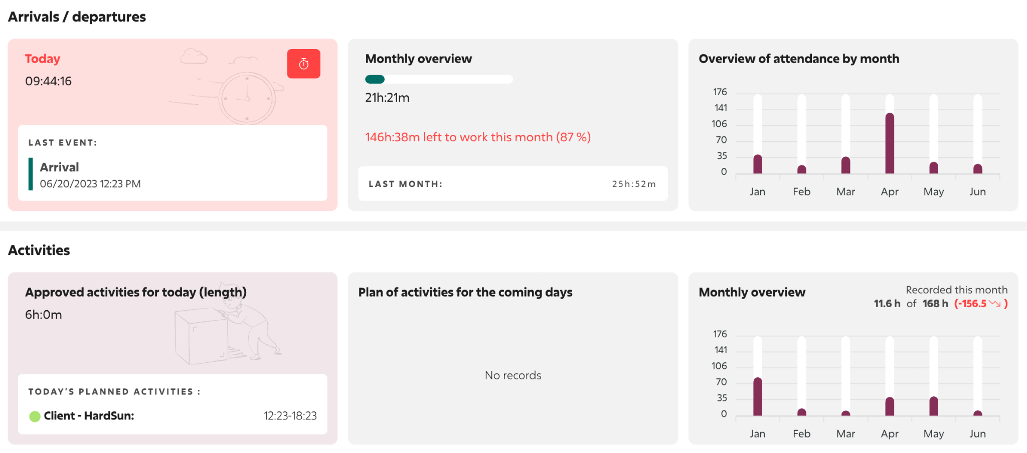
Where can I quickly see how much I have worked?
Need to quickly see how much time you worked on a given day or month by attendance or activity? That's why we have the Quick Overview section. 👇

Slide 9
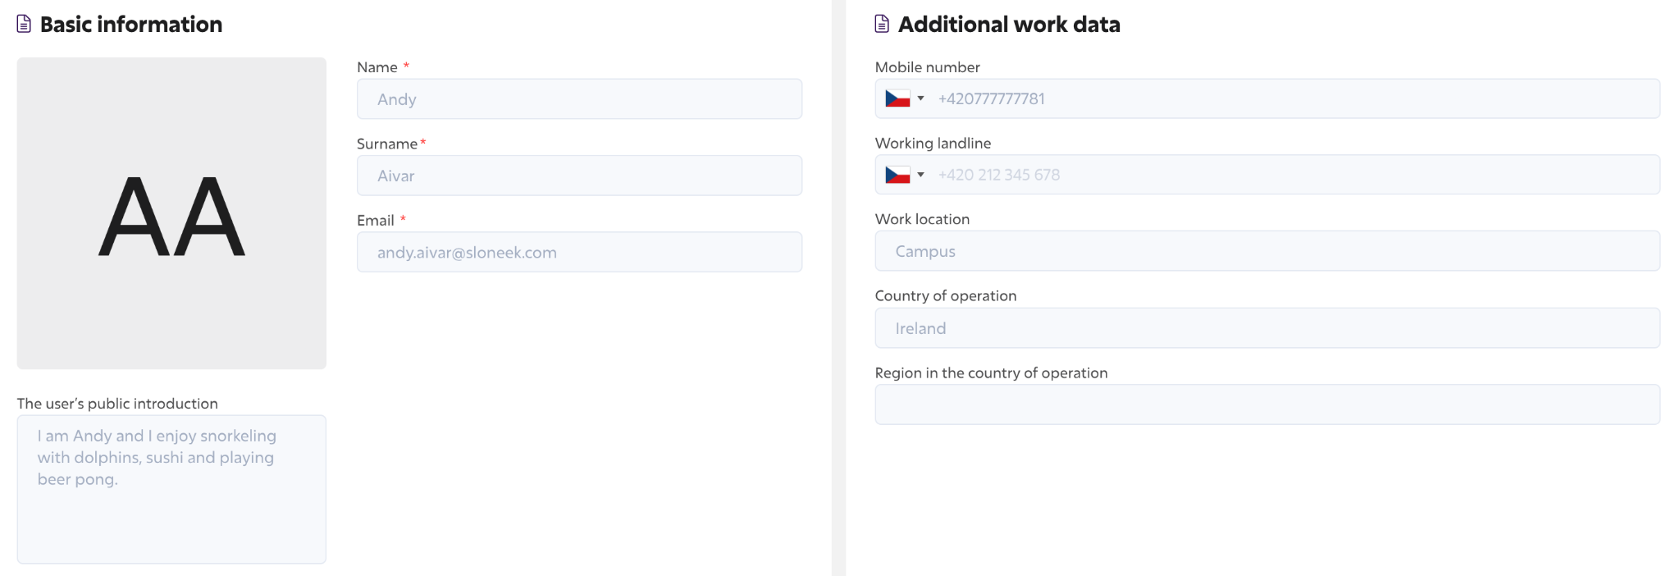
All your colleagues in one place
There may be times when you need to contact some of your colleagues in the company with whom you are not on the same team. Or just to see what they are actually doing in the company. 😀
Just go to the Colleagues section and you can immediately find the contact details of any colleague:

Slide 10
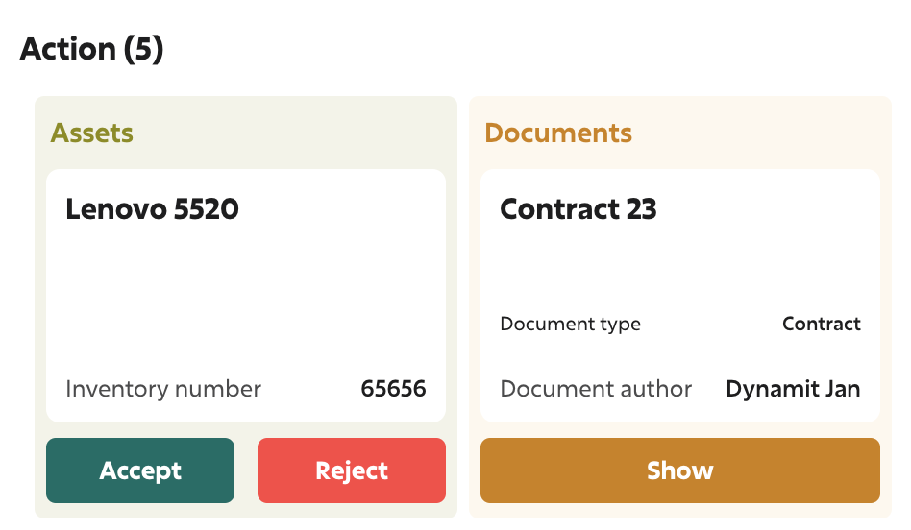
How to sign a document and take over the asset?
?
The moment a document or work asset is assigned to you, you will receive a notification in your email and app. At the same time, Sloneek will also notify you on the main dashboard that an action is required of you:
🖋 Simply click on the document or work asset detail, and if they require a signature, sign it electronically and securely.

Slide 11
Always keep up to date with what's new
🎉
👀 Your dashboard is the place where you can find out what's new in the company the fastest. Take a minute here every day to stay in the loop.
Right on the main dashboard in the app, you can:
Read important company announcements
Post and receive kudos
Quickly find out which colleagues are not at work that day
See who is celebrating a birthday or work anniversary
❗️

Slide 12
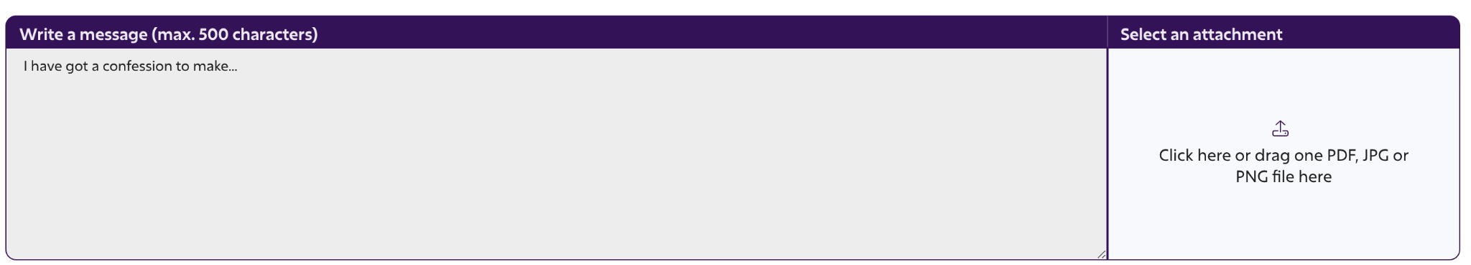
Anonymous trust box
Do you want to report a problem in your company or are you just worried about something? Send it anonymously to the trust box. Your suggestions can make things better.

Slide 13
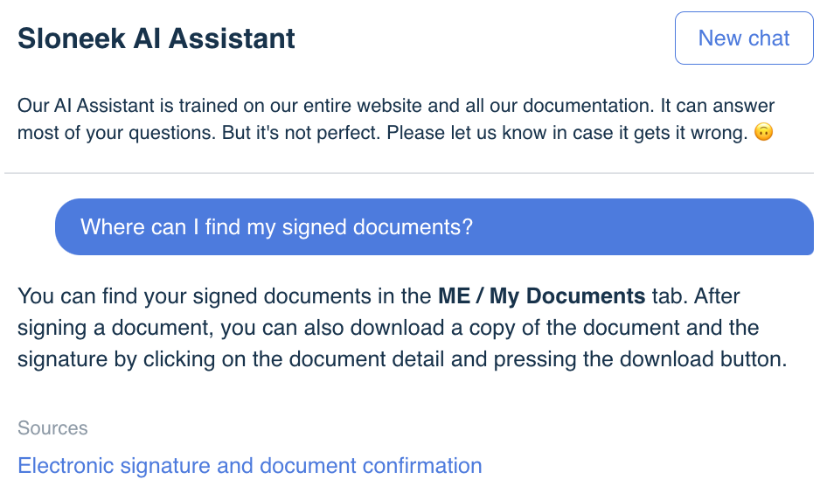
AI assistant is there for you 24/7
Before you go looking for help from your HR, try our AI assistant. It's powered by ChatGPT-4 and can answer most of your app-related questions. 😊
You can find the AI assistant under the question mark bubble in the bottom right corner of the page.
👾

Slide 14


Everything at your fingertips with the mobile app
Also try our mobile app! You can conveniently enter your vacation or attendance with just a few clicks. It's simple and practical.

Slide 15

Thank you for using us.

